Slide 1
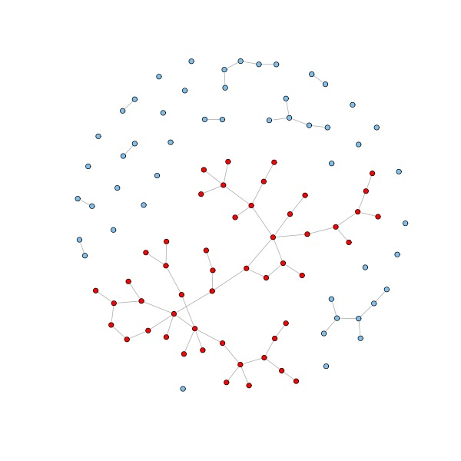
Largest connected component of a graph
(LCC)

Slide 2
Team:
Mahmoud Mohamed Taha
Mohamed Abdul-Nasser
Mohamed Jamal Hanafy
Sara Hesham Hassan
Tasneem Mohamed Saad
Wssam Hassan Ibrahim

Slide 3
01
02
Introduction
Applications
03
Approaches
Agenda
04
Code

Slide 4

Introduction
01

Slide 5
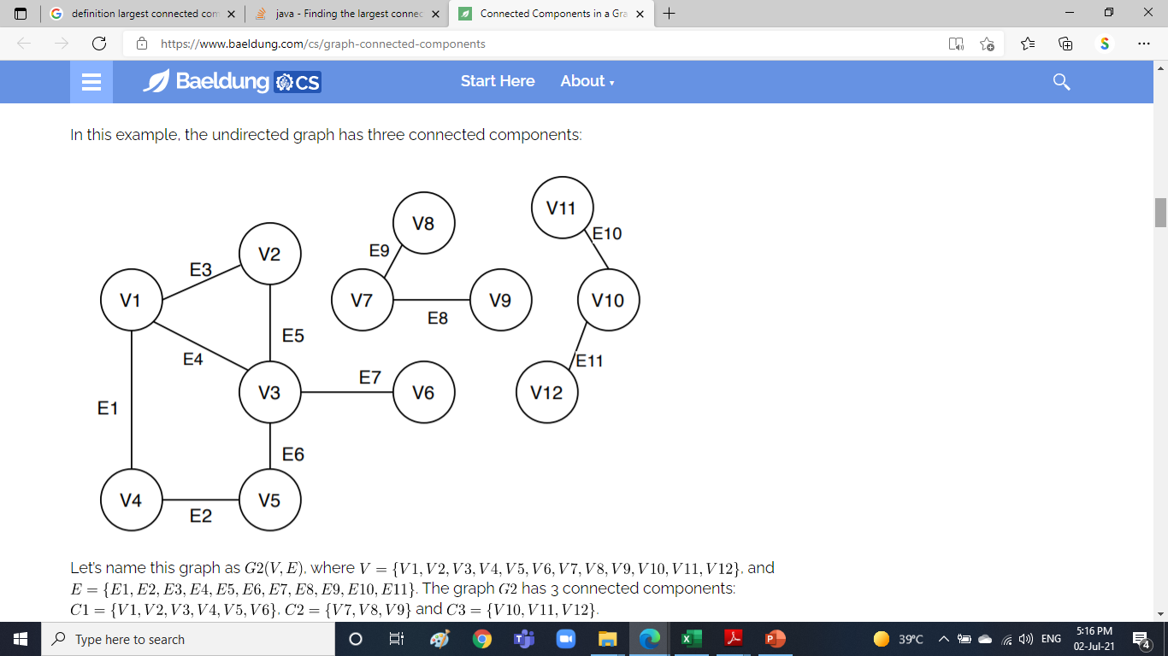
LCC Definition
A connected component or simply component of an undirected graph is a subgraph in which each pair of nodes is connected with each other via a path.

Slide 6

Applications
02

Slide 7
Applications
Fine MRI brain images
Iso-surface Topology Simplification
protein-protein interaction graph
01
03
02

Slide 8

Approaches
03

Slide 9
Approaches
DFS
BFS
Disjoint Sets
Partitioning
01
02
03
04

Slide 10

Code
04

Slide 11
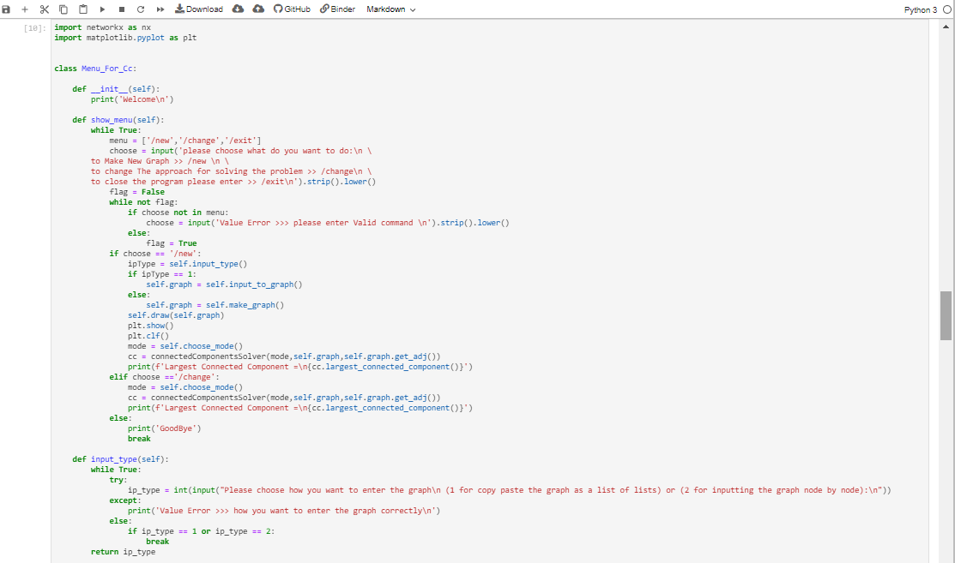
Menu..

Slide 12
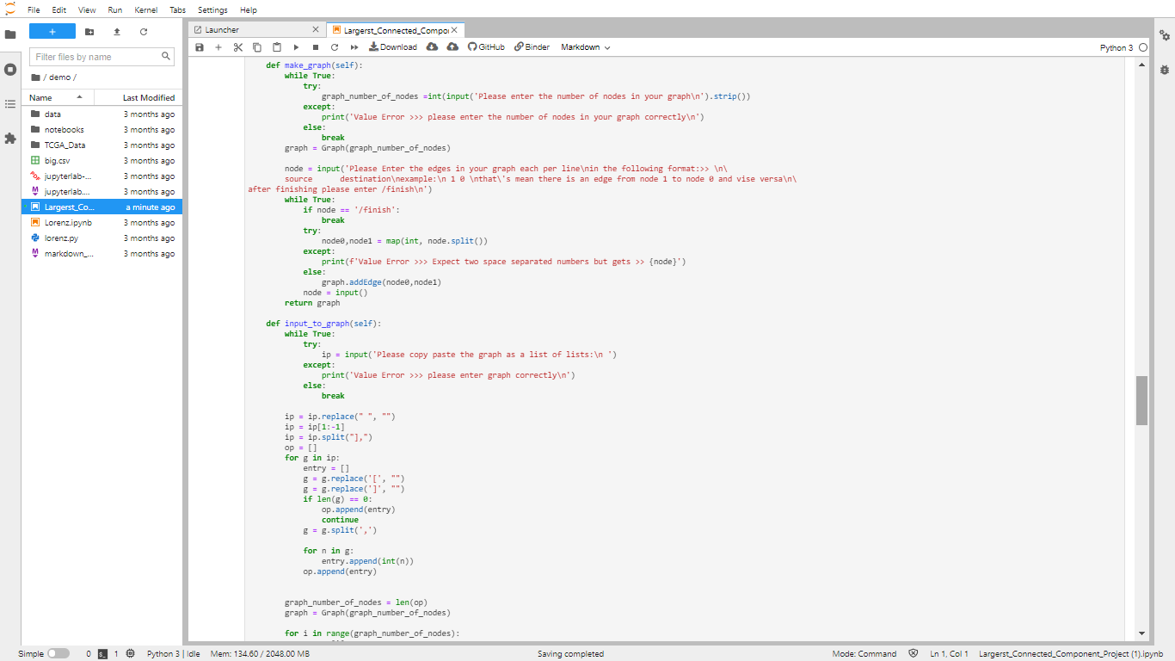
Menu..

Slide 13
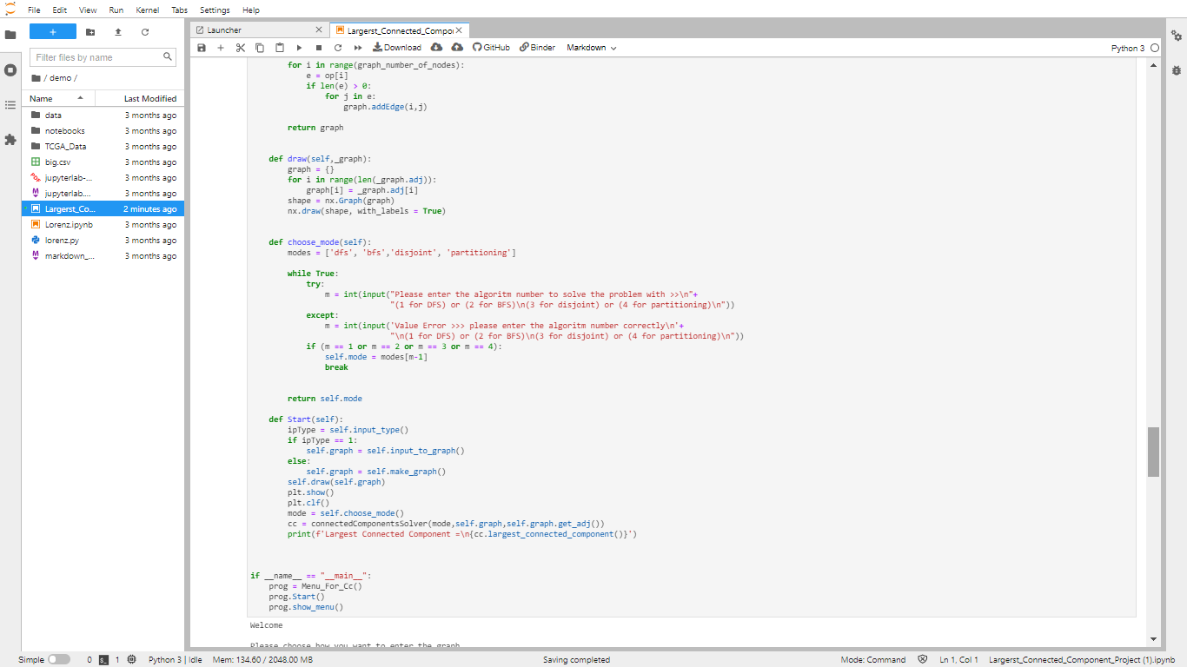
Menu..

Slide 14
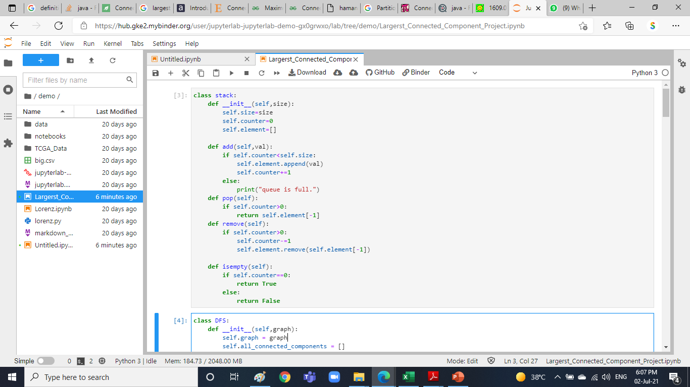
Stack..

Slide 15
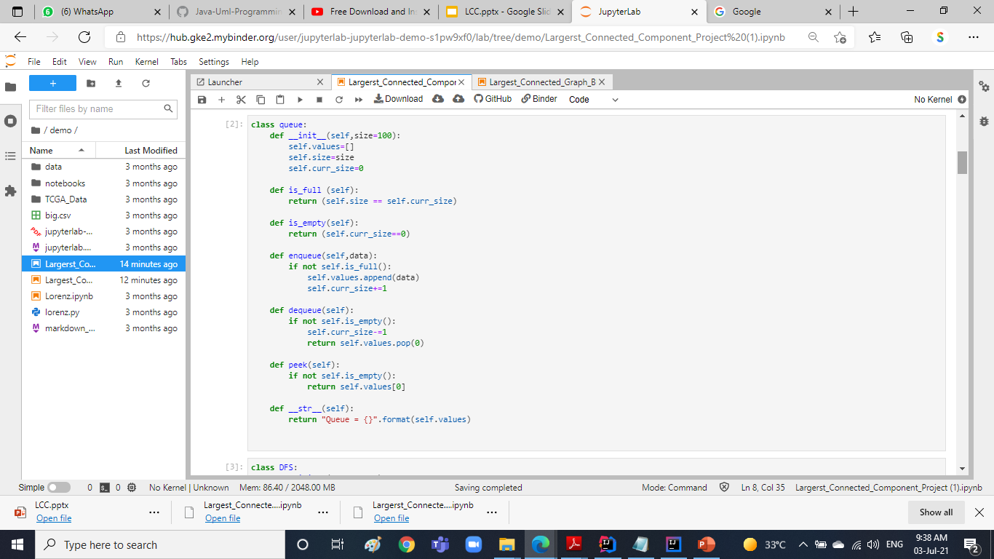
Queue..

Slide 16
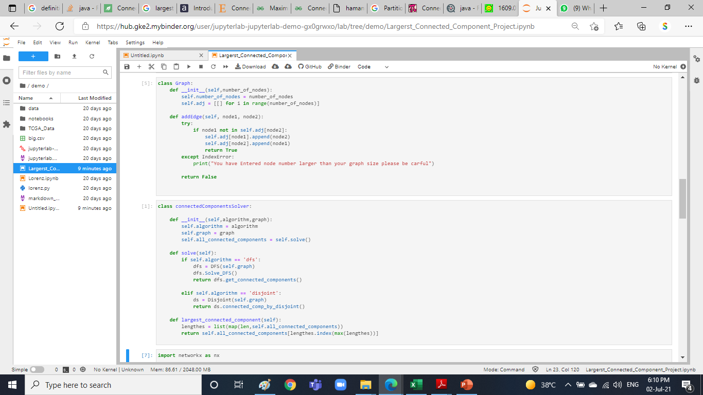
Graph..
Solver..

Slide 17
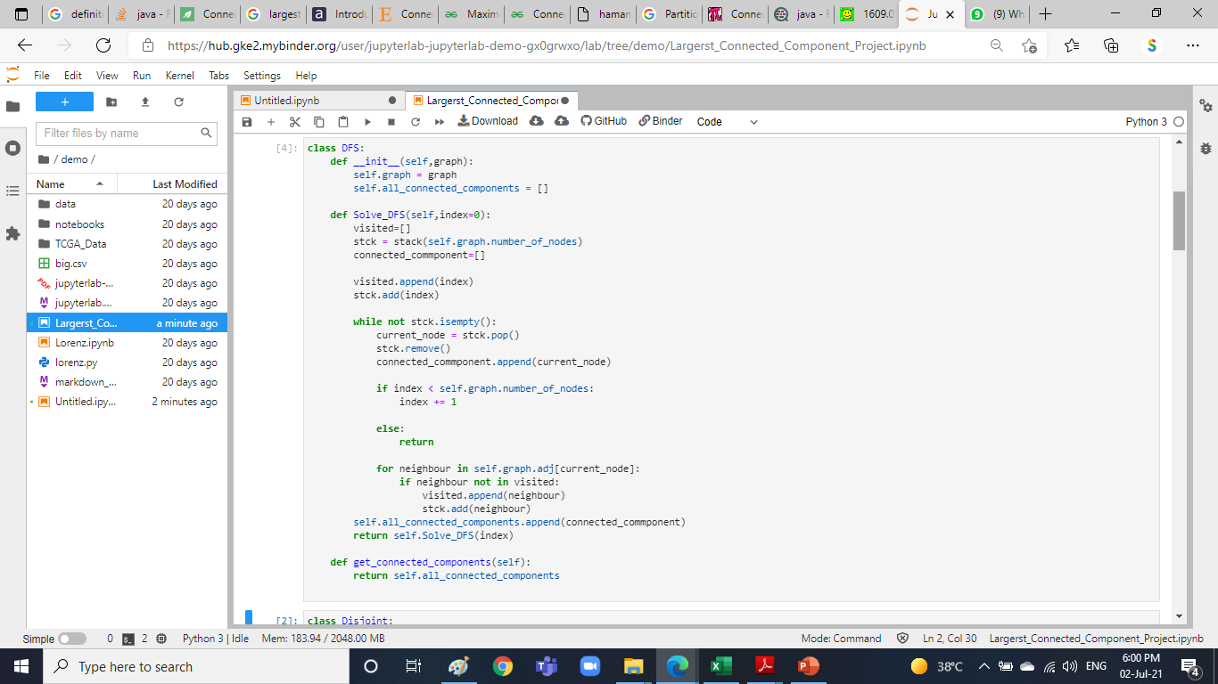
DFS..
Time complexity: O(V+E)
Space complexity: O(n)

Slide 18
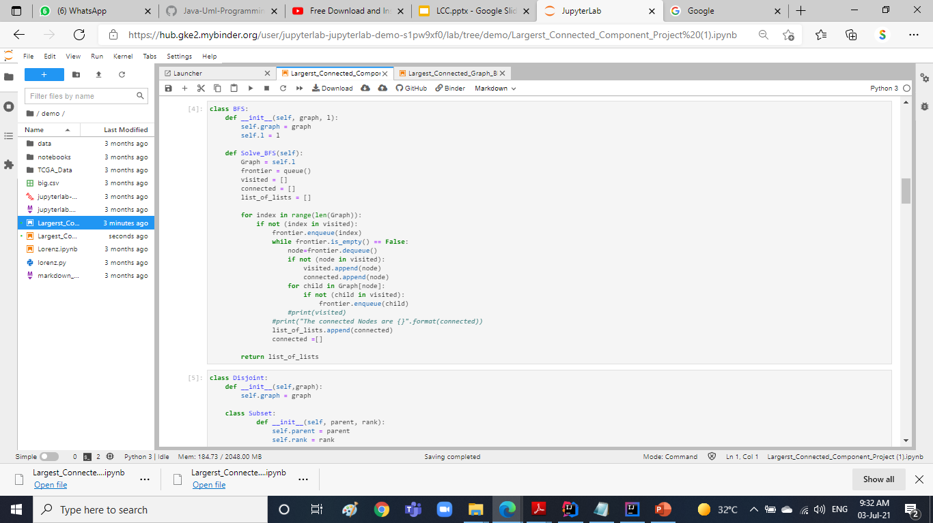
BFS..
Time complexity: O(V+E)
Space complexity: O(n)

Slide 19
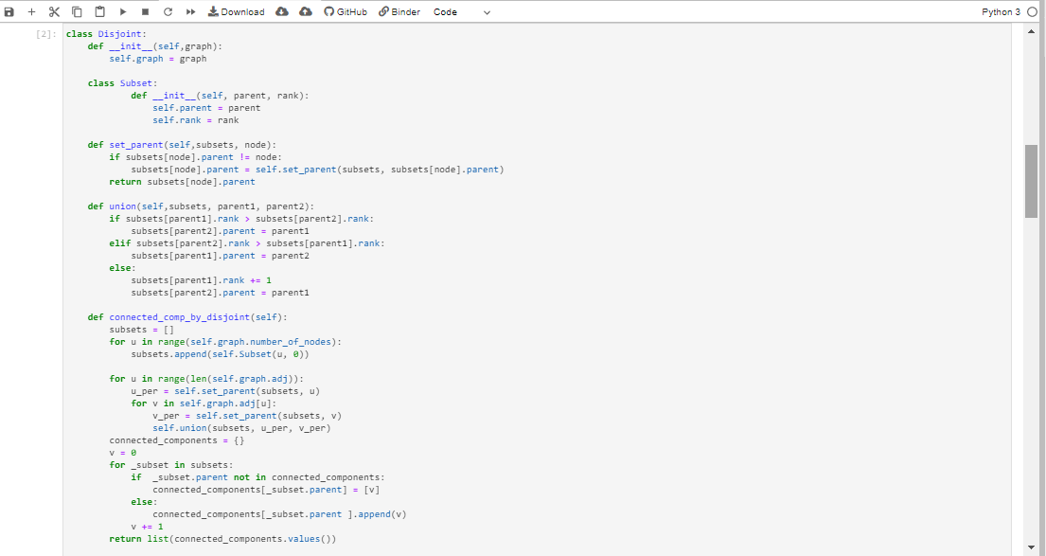
Disjoint sets..
Time complexity: O(n2)
Space complexity: O(n)

Slide 20
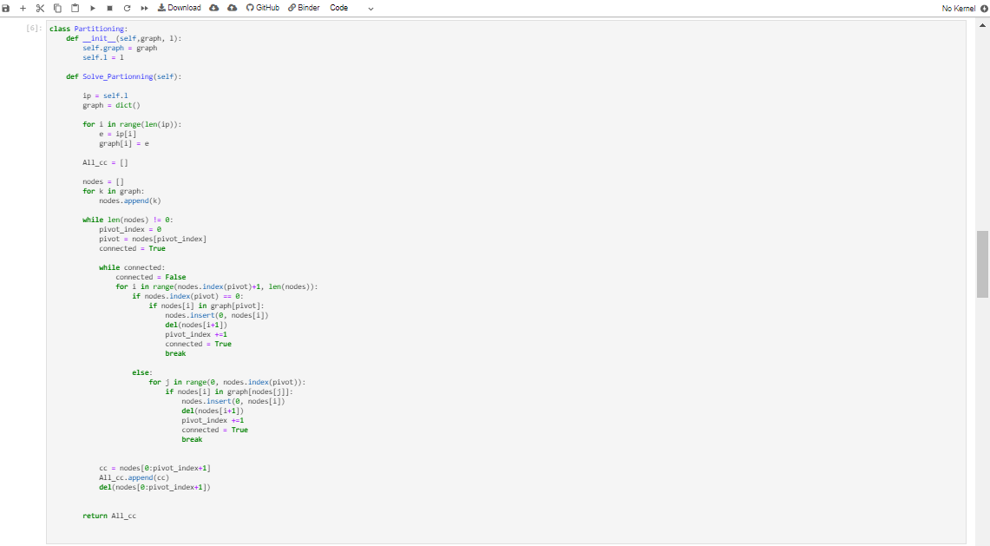
Partitioning..
Time complexity: O(n2)
Space complexity: O(n)

Slide 21
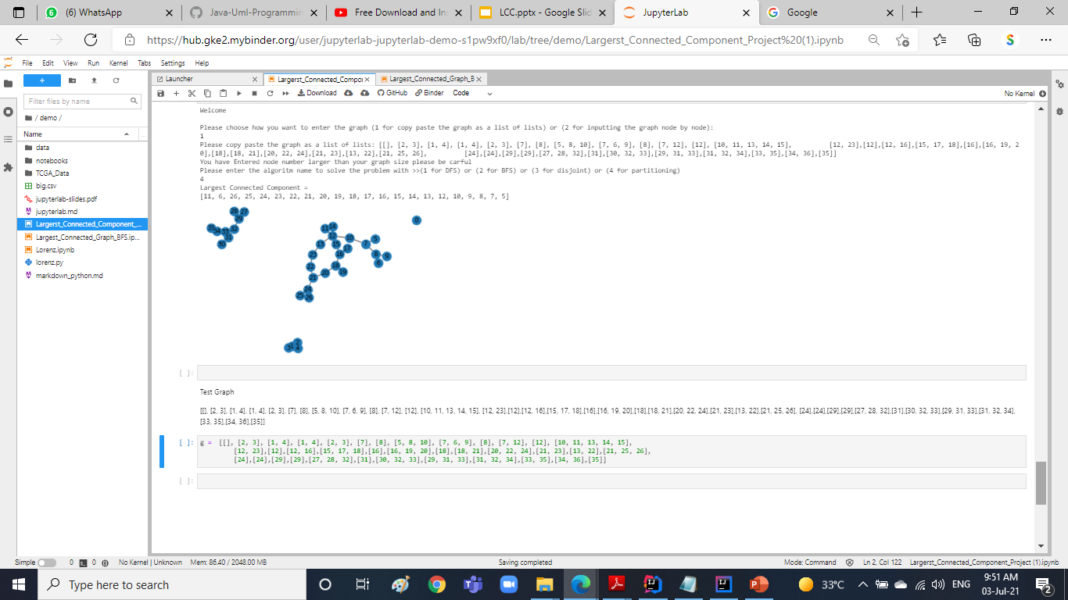
Output..

Slide 22
Thank you
Do you have any questions?

